Slide 1
The Drive-In Cinema Lebanon
Software engineering - COE461
Dr. Joe Tekli
Zene Ashour
Zouheir Al Jamal
Anthony El Khoury

Slide 2
Outline
01
02
03
04
05
Introduction & Background
Proposal
Requirements
Conclusion
Implementation & Testing

Slide 3
Introduction
Due to the presence of COVID-19, A cinema booking system is needed to ensure minimal human contact
Therefore , The drive-In cinema website was developed achieving the following objectives:
Having a database containing all needs details of the movies, cars,clients and vending trucks available.
Allowing clients to search and reserve any movie of their choice based in parking spot availability and showtime
Ordering food, beverages and snacks from the food court to their cars
Donates extra funds to the NGO “NUSAND” if desired.
The website is accessible by administrators and clients

Slide 4
Background
Drive-In cinema is the best safe alternative where clients sit in their own cars with minimal to zero interaction with other people
The Online Drive-In Cinema Booking System, is another tool that elevates the levels of safety and measurements.
The developed product includes a website which provides movie management capabilities to administrators, and user-friendly interface for the clients to search, reserve, and book parking spots online, in an efficient manner.
There are numerous websites and applications that allow users to search and book movie seats in cinema theaters. However, since the Drive-In Cinema is the first car cinema in Lebanon, we made some changes differing from any typical cinema booking websites:
Instead of booking a seat, now the client will be booking a parking spot.
Extra information about a car type and model will be required to assure the every car will be able to watch the movie clearly
Since the event is working alongside an NGO, a donation option will also be added to the website.

Slide 5
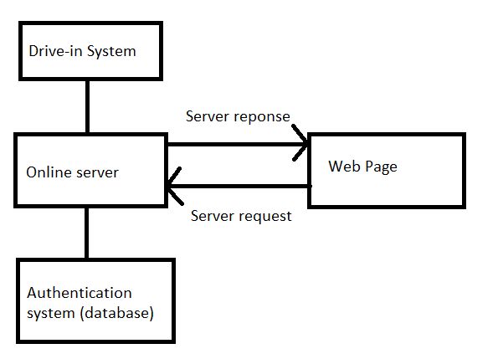
Proposal
General Architecture:
Since this is a data-centric product, the Online Server needs a database to store data.
All of the database communication goes over the Internet.
The Online server uses the Authentication System to validate user sign-in information, the database to display all movies live, and a number of js scripts to perform certain tasks

Slide 6
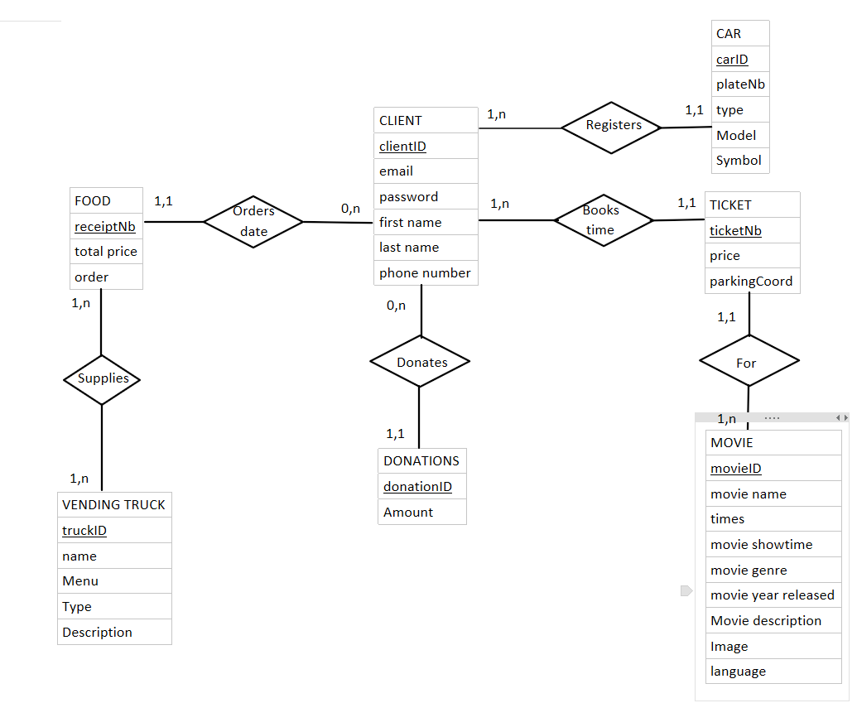
Database (E-R)

Slide 7
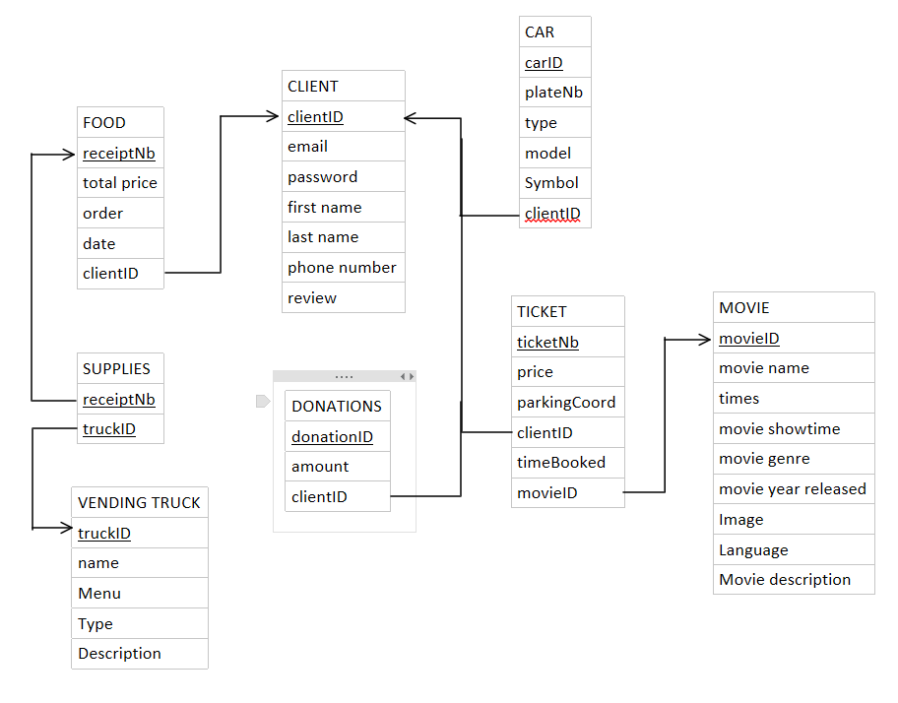
Database (LDM)

Slide 8
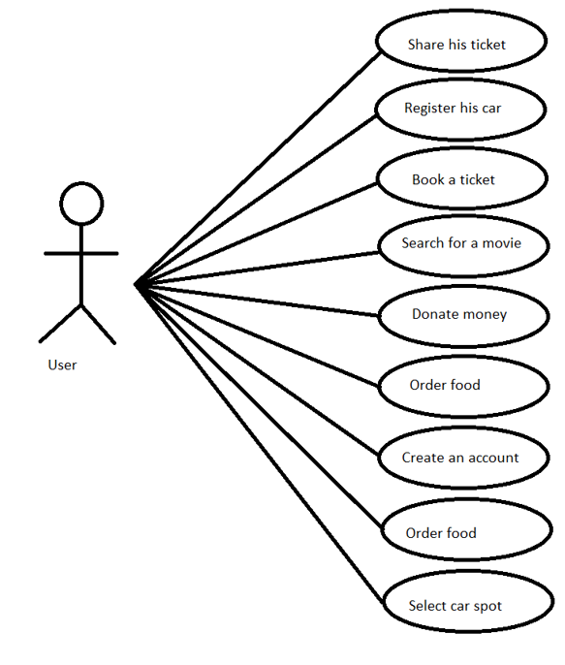
Functional Requirements
User Viewpoint
Users use case diagram
The client is the only user, given all the privileges

Slide 9
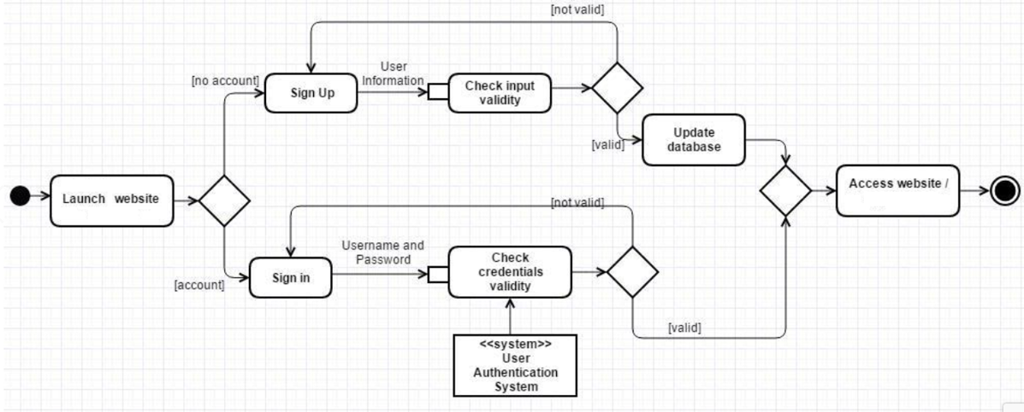
Functional Requirements
User Viewpoint
Activity diagram describing sign-in and sign-up activities

Slide 10
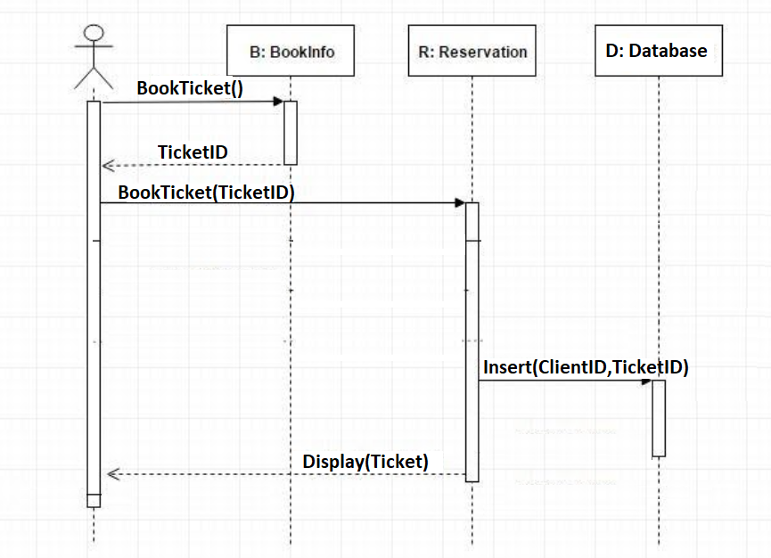
Functional Requirements
User Viewpoint
Sequence diagram describing the ticket reservation

Slide 11
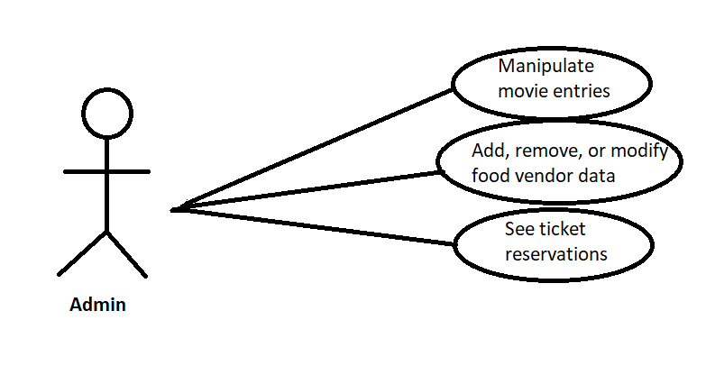
Functional Requirements
Administrator Viewpoint
The functional requirements within the administrator viewpoint are:
Log in with his/her credentials.
Delete, add, or modify food vending truck information.
Know how many tickets were ordered for each movie.
Manipulate any entity from the movie selection found in the database.
Administrator Viewpoint use case diagram

Slide 12
Non-Functional Requirements
01
02
03
04
05
06
Availability
Usability
Maintainability
Portability
Security
Performance

Slide 13
Underlying Concepts
Better User Experience (Car Type Specification )
The car type specification is an option added in the entity car which differentiate a user’s sedan car from another user’s truck, since each will be having a special place in the booking GUI to enhance the view of the screen for all users while distributing their spot in an equally manner

Slide 14
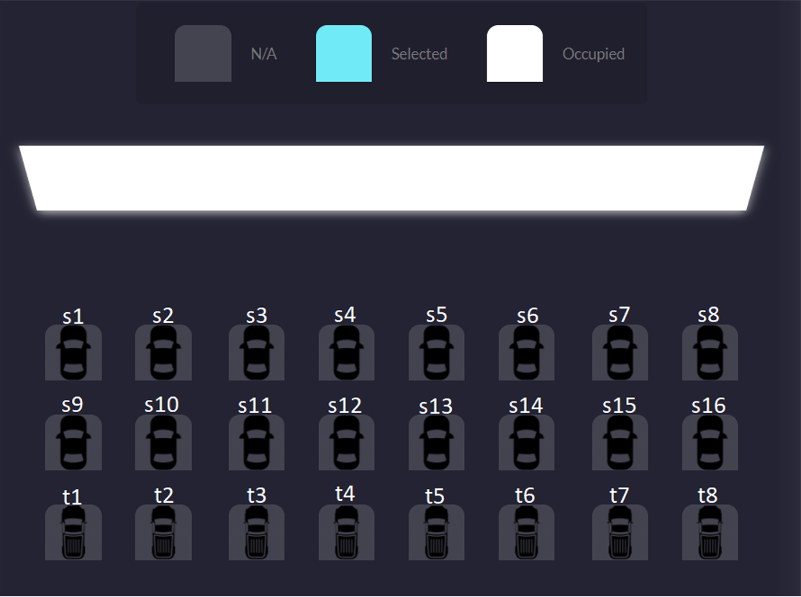
Building Blocks
Car spot booking GUI
One of the main enhancements for a better user experience:
The client could see how the car will be aligned the day of the movie, while displaying the available and reserved seats.
Depending on what type of car the user has, he could choose a spot which is either a sedan car or a truck.

Slide 15
Building Blocks
Ticket Sharing
The user has the ability to share his ticket with a friend which will be in form of a PDF that could be downloaded or even printed to be used on the day of the movie

Slide 16
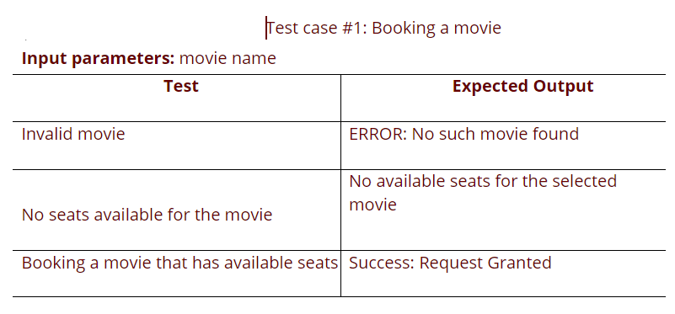
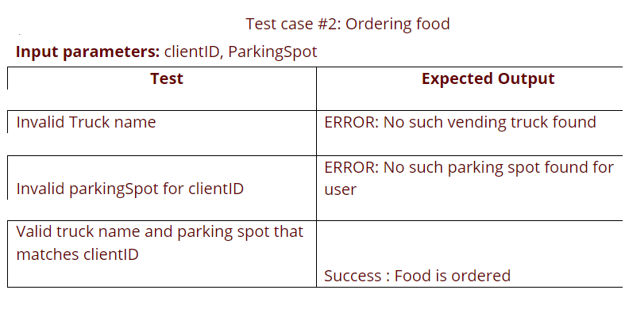
Testing Cases

Slide 17
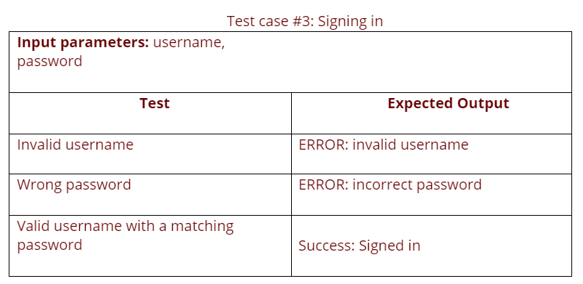
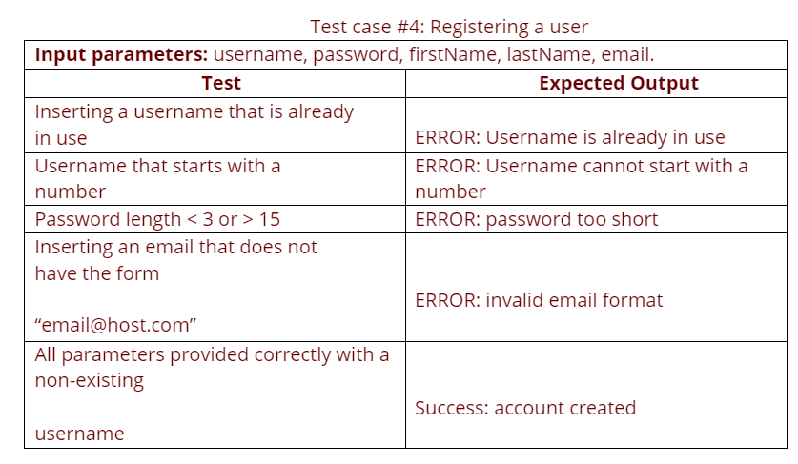
Testing Cases

Slide 18
Conclusion
As a future improvement to our project, we suggest making a mobile application which will make the drive-in cinema a multi-platform system, that can run not only on Android-based phones, but also on phones that use iOS and Windows as their operating systems.
Also, the recommendation system can be improved to include friends that have watched the movie and what food is mostly ordered which will give the user more experience regarding the vending trucks and movies.

Slide 19
References
W3schools. (2021). W3schools. https://www.w3schools.com/.
Ian Somerville, Software Engineering, 9th Edition, Pearson, 2011.
Davis M A, “Just Enough Requirements Management: Where Software Development Meets Marketing”, New York, Dorset House Pub-lishing, 2005.

Slide 20
Thanks!

